Slide 1
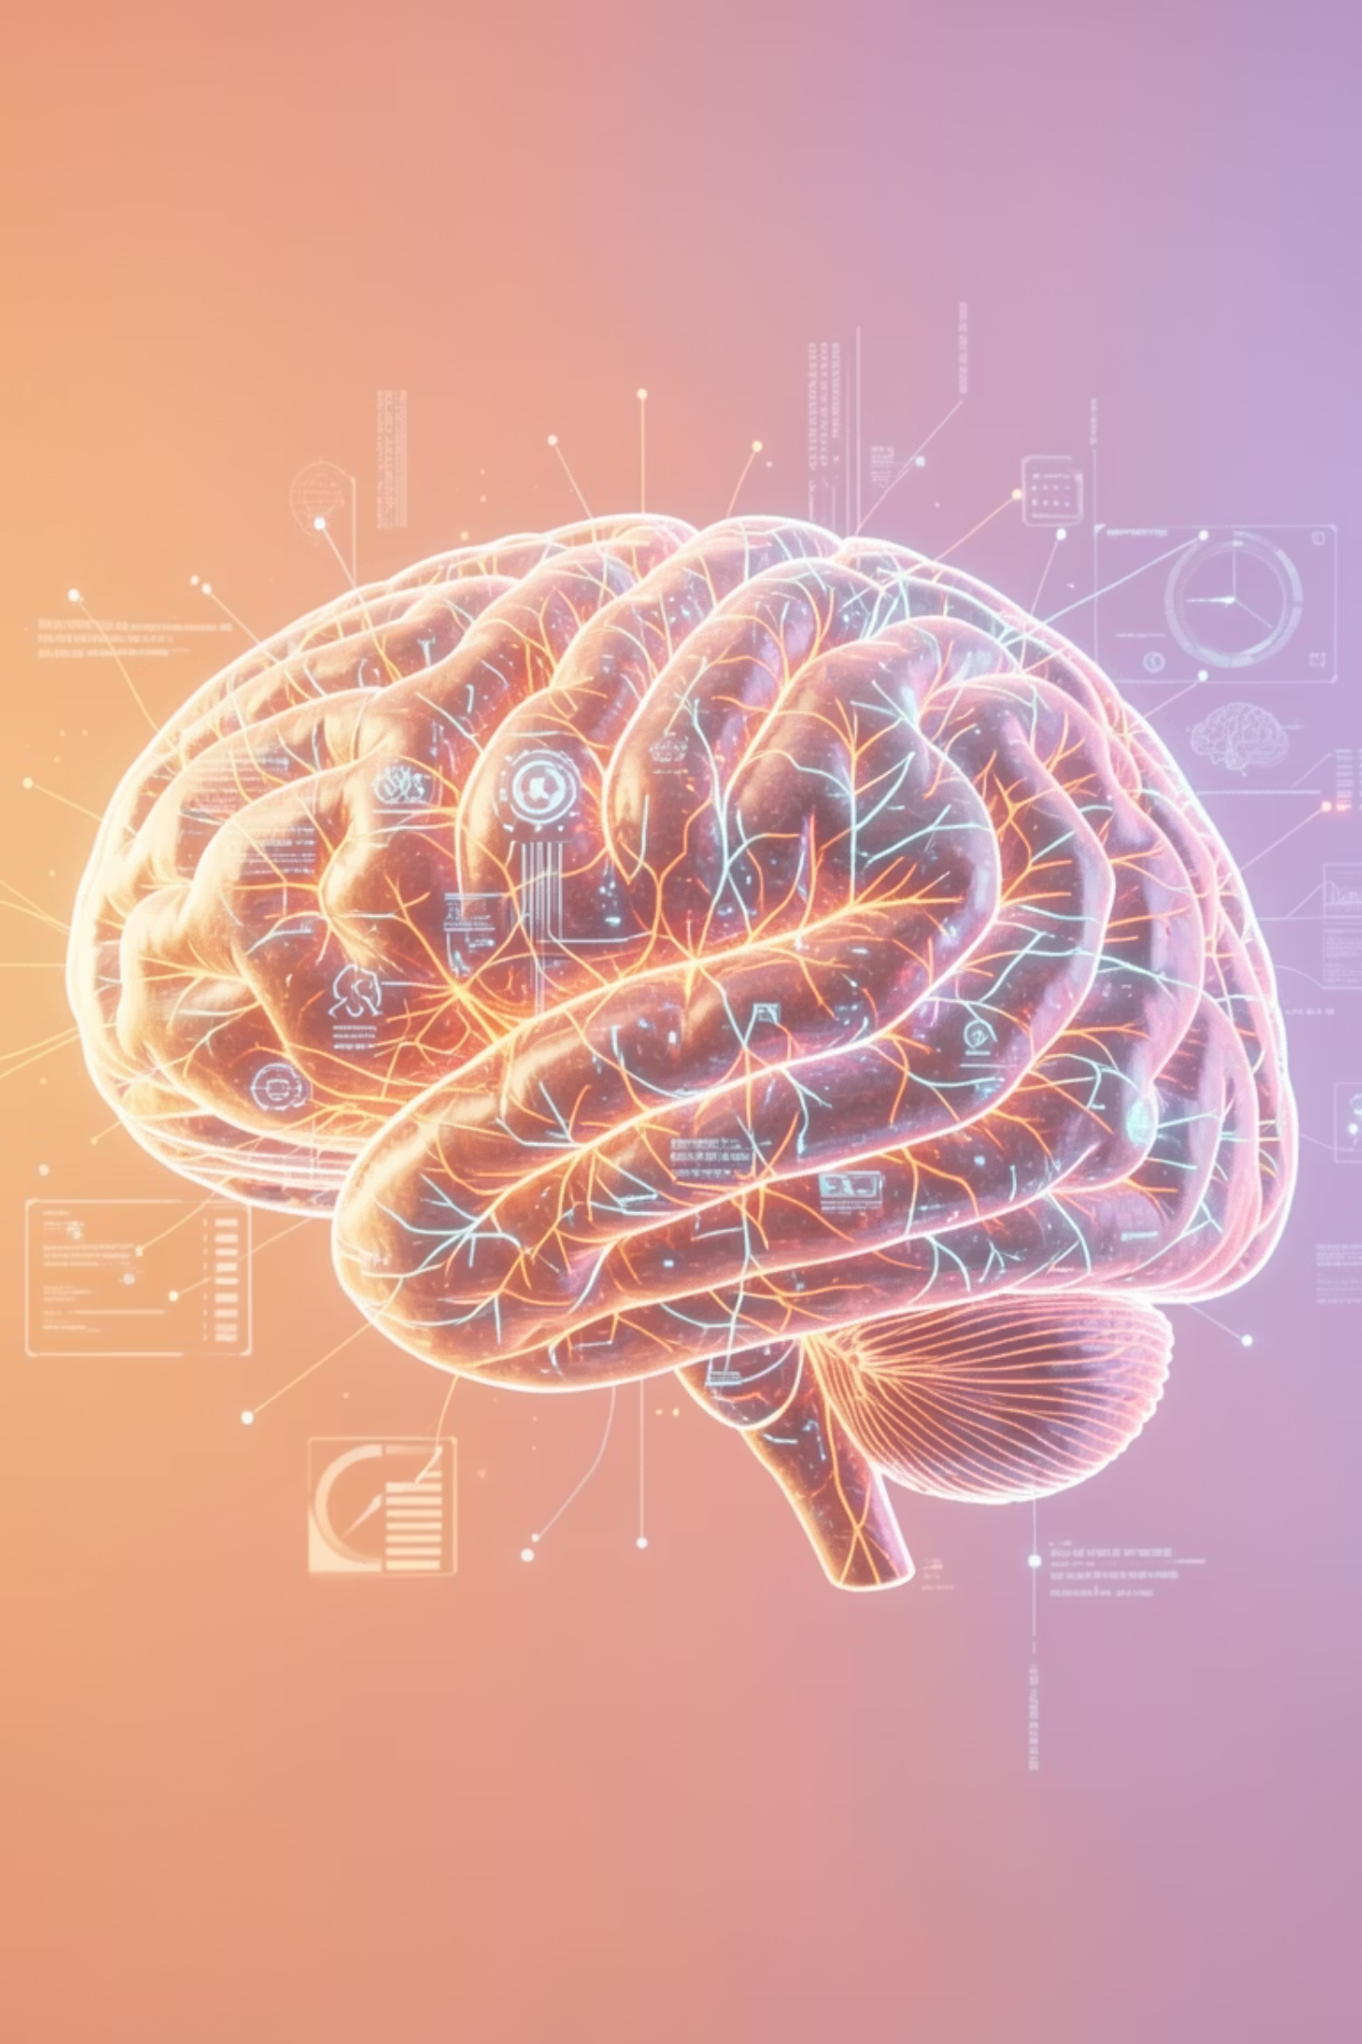
Generative AI – 1 Week Workshop Program
Transform your career in just 7 days with our intensive program. Learn to create stunning content using AI—from compelling text to eye-catching images and professional videos. 2 hours daily, 14 hours total investment in your future.

Slide 2

WHY LEARN AI
Why Generative AI Matters Now
Universal Transformation
Emerging Careers
Every industry—from healthcare to entertainment—is integrating AI to stay competitive and innovative.
New roles like Prompt Engineer and AI Content Creator are offering lucrative opportunities worldwide.
Speed & Efficiency
Future-Proof Skills
Create content and designs in minutes that once took hours or days to produce manually.
AI expertise is becoming essential, with demand growing exponentially across all sectors.

Slide 3
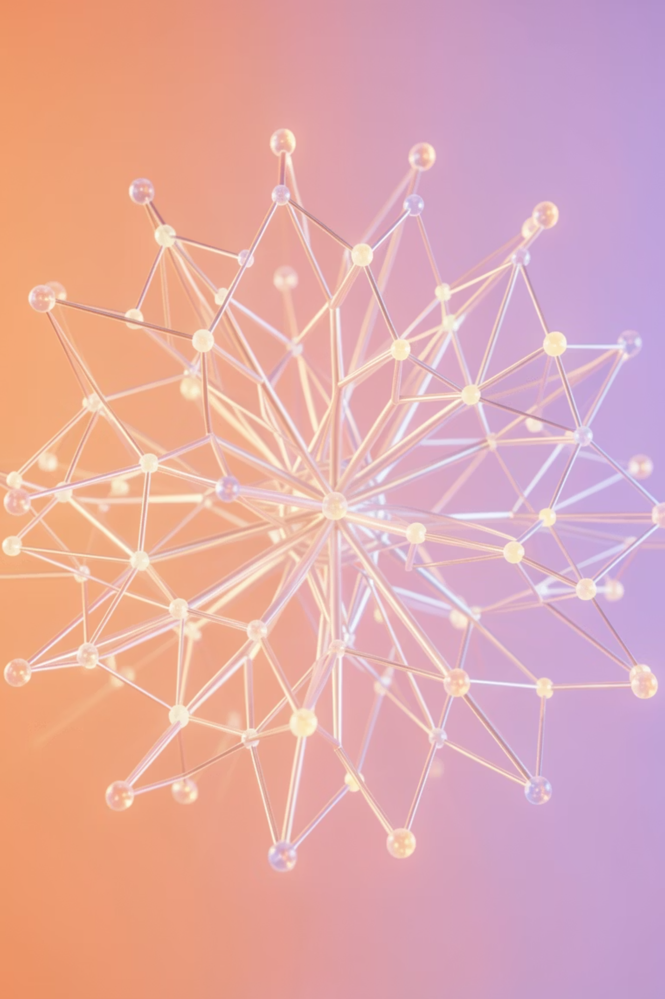
FUNDAMENTALS
Understanding AI, ML & Generative AI
Artificial Intelligence (AI)
Machines that can perform tasks requiring human intelligence—like reasoning, learning, and problem-solving.
Machine Learning (ML)
A subset of AI where systems learn from data, identify patterns, and make decisions with minimal human intervention.
Generative AI
The cutting edge—AI that creates entirely new content including text, images, and videos from simple prompts.

Slide 4
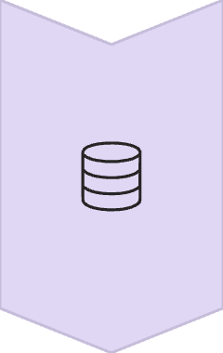
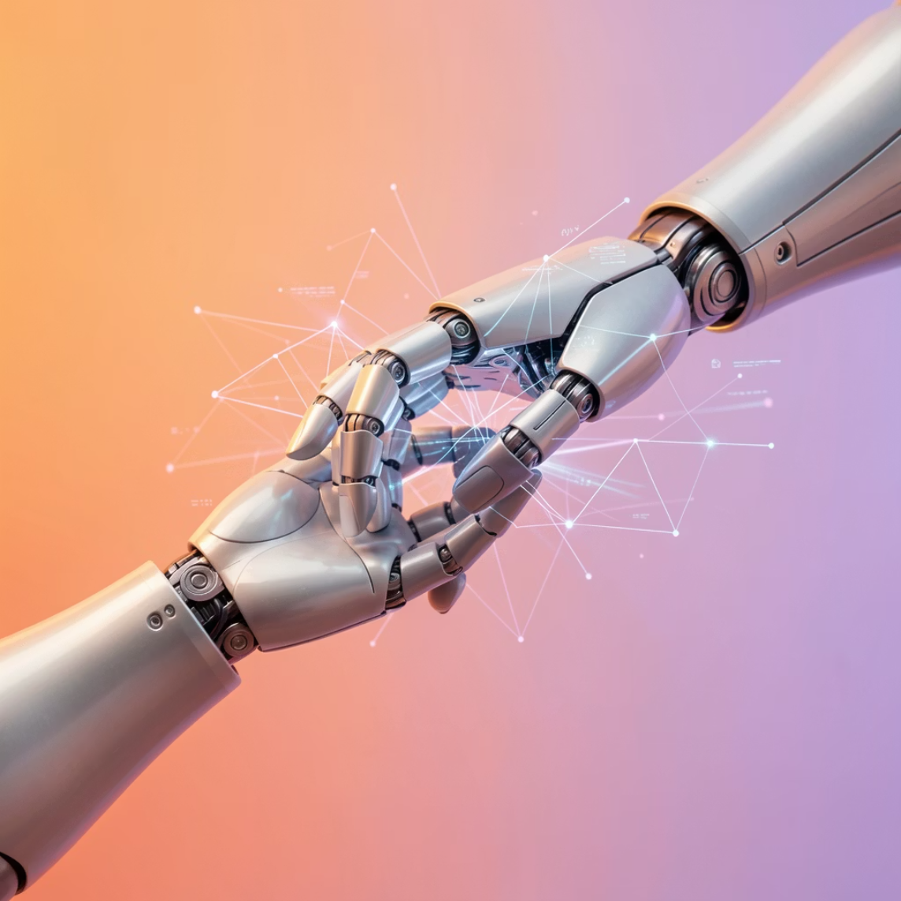
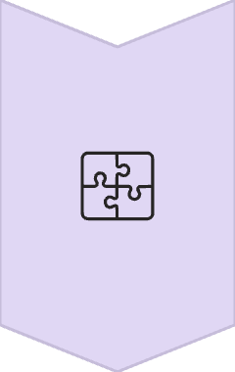
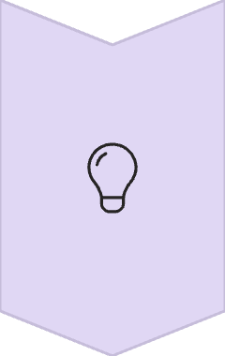

How Generative AI Creates Magic
Training on Big Data
AI models learn from massive datasets containing billions of examples from text, images, and videos.
Understanding Patterns
The system identifies complex patterns, relationships, and structures in the training data.
Predicting Next Output
Using learned patterns, AI generates new content by predicting what should come next in the sequence.
Popular Tools: ChatGPT for text, Gemini for conversations, DALL-E for images, and Veo 3 for professional video generation.

Slide 5
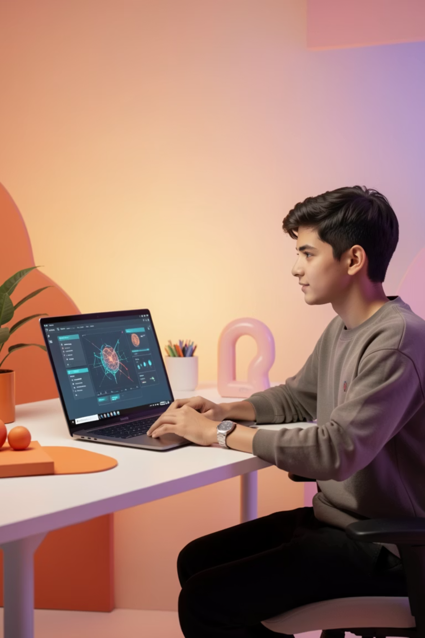
PROGRAM STRUCTURE
Your 7-Day Transformation Journey
7
2
14
Intensive Days
Hours Daily
Total Hours
One full week of focused learning and skill development
Manageable commitment that fits your schedule
Comprehensive training from basics to advanced
Hands-On Practical Sessions
Live Demonstrations
Work directly with industry-standard AI tools and platforms to build real-world skills.
Watch experts create content in real-time, learning professional techniques and best practices.
Final AI Project
Showcase your new skills by creating a complete AI-powered project for your portfolio.

Slide 6

DAYS 1–2
Building Your AI Foundation
01
AI & Language Models (LLMs)
Understand how large language models work and why they're revolutionizing content creation.
02
Real-World Use Cases
Explore practical applications across industries—from marketing to healthcare to education.
03
Prompt Engineering Basics
Master the art of communicating with AI to get exactly the results you want.
04
Advanced Prompting Techniques
Learn sophisticated strategies like chain-of-thought prompting and role-based instructions.
05
Interactive Story Activity
Create your first AI-generated story, applying everything you've learned hands-on.

Slide 7
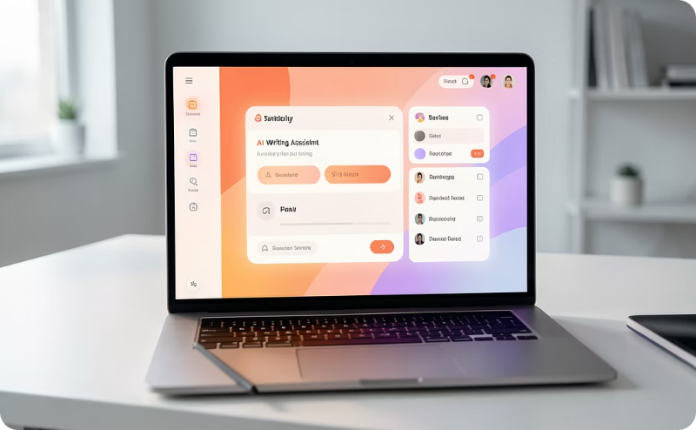
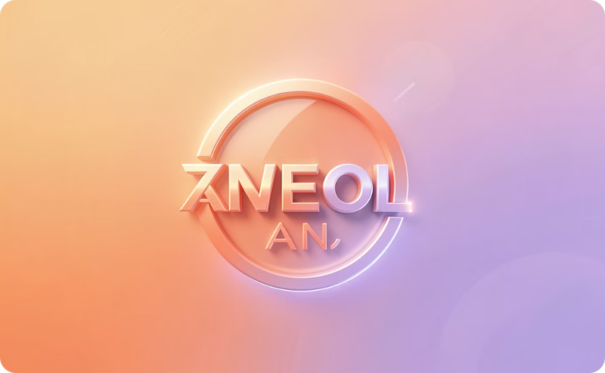
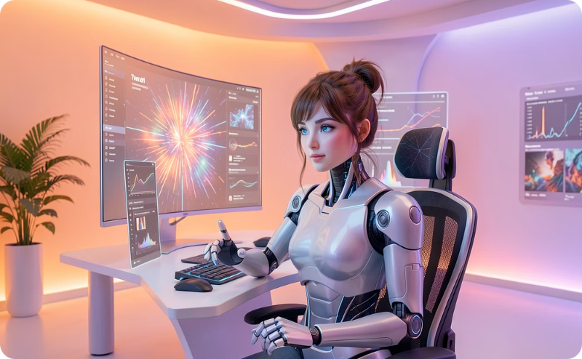
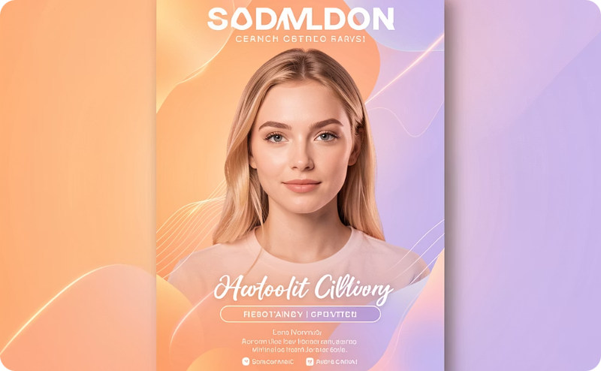
DAYS 3–4
Creating Content & Visual Masterpieces
Content Creation Mastery
AI-Powered Branding
Text-to-Image Generation
Professional Design Work
Generate engaging blogs, viral social media reels, and compelling captions that capture attention and drive engagement.
Build complete brand identities including logos, color schemes, and visual guidelines using intelligent design tools.
Transform written descriptions into stunning visuals, learning to craft effective prompts for perfect results.
Create posters, social media graphics, and marketing materials using Midjourney, DALL-E, and Canva AI.

Slide 8
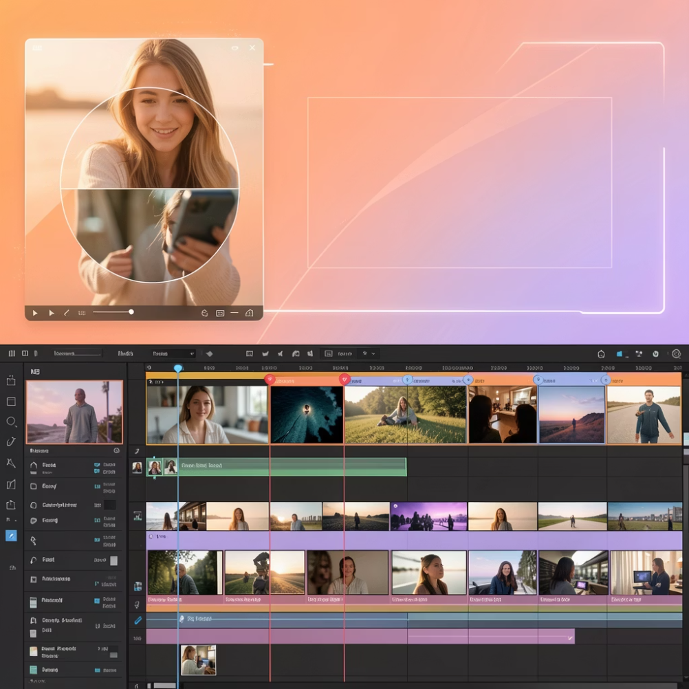
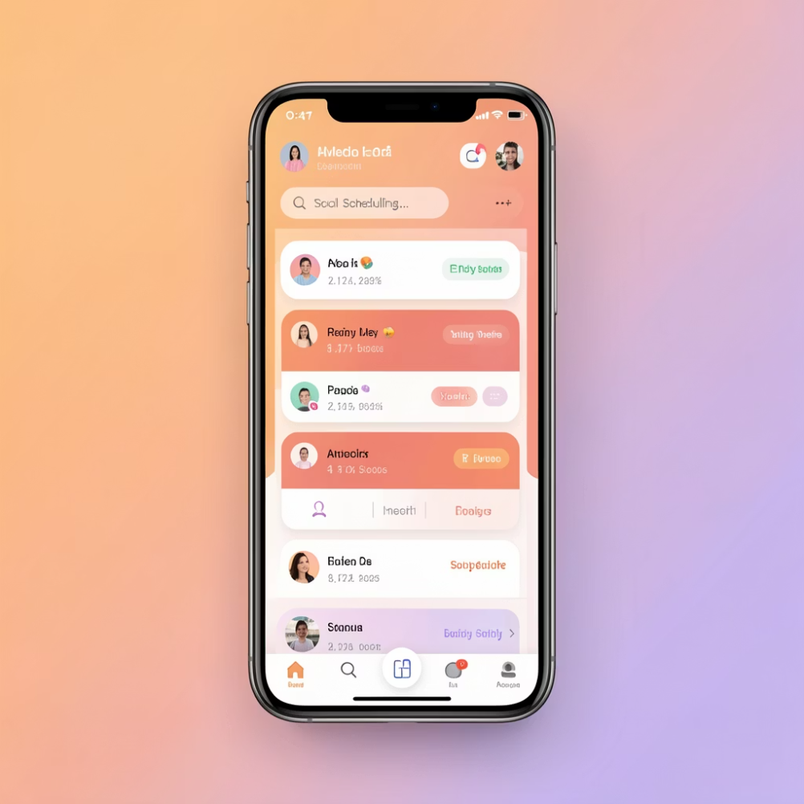
DAY 5
Video Creation & Automation
1
Text-to-Video Magic
Transform scripts into professional videos instantly using AI-powered video generation platforms.
2
AI Voice & Subtitles
Add natural-sounding voiceovers in multiple languages and generate accurate, synchronized subtitles automatically.
3
Social Media Reels
Create engaging short-form content optimized for Instagram, TikTok, and YouTube Shorts with AI editing.
4
Automation Workflows
Set up systems to automatically schedule, post, and manage content across multiple social platforms.

Slide 9

DAY 6
Launch Your AI Career
AI Content Creator
Prompt Engineer
Produce high-quality content at scale for brands, businesses, and media companies seeking modern solutions.
Become an expert in crafting effective prompts—one of the most in-demand tech skills today.
AI Marketing Specialist
Help businesses leverage AI for campaigns, automation, and data-driven marketing strategies.
Freelancing Opportunities
Learn how to position yourself on platforms like Fiverr and Upwork, where AI skills command premium rates. Discover pricing strategies, client communication, and service packaging.
Build a compelling portfolio showcasing your AI-generated work. Learn to present case studies that demonstrate your expertise and attract high-paying clients.

Slide 10
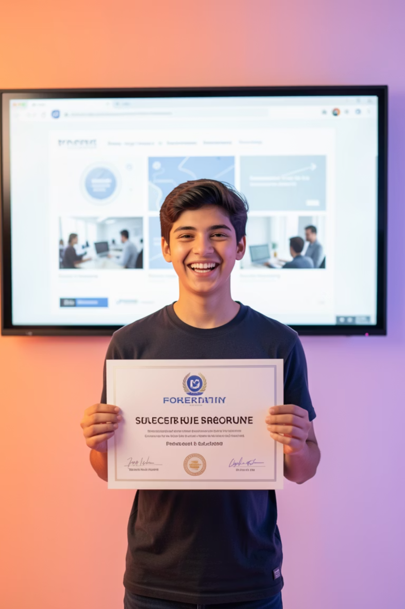

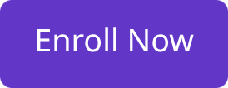
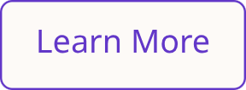
DAY 7
Your Final Project & Certification
1
Create Your Masterpiece
Choose between producing a short AI film, designing a complete brand identity with posters, or developing a comprehensive branding campaign.
2
Present Your Work
Showcase your project to peers and instructors, demonstrating your understanding and creative application of AI tools.
3
Receive Certificate
Earn your completion certificate recognizing your new AI skills and readiness for professional opportunities.
You'll Graduate Career-Ready
With hands-on experience, a professional portfolio, and the confidence to take on AI projects or pursue exciting career opportunities in this rapidly growing field.

